Slide 2

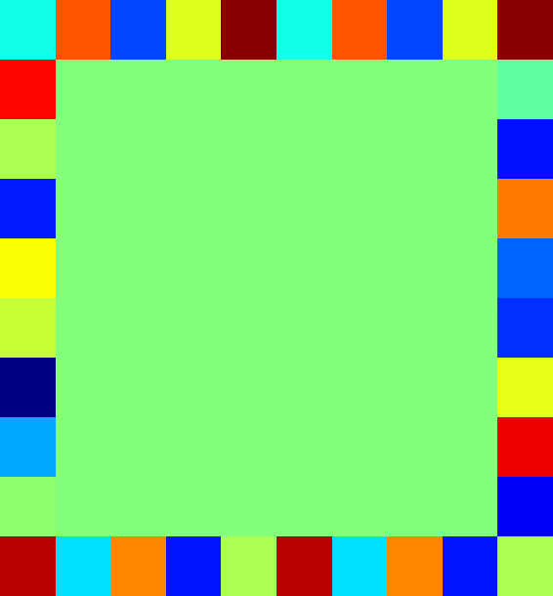
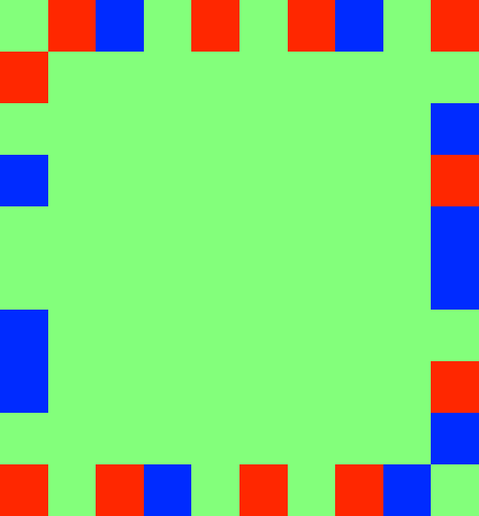

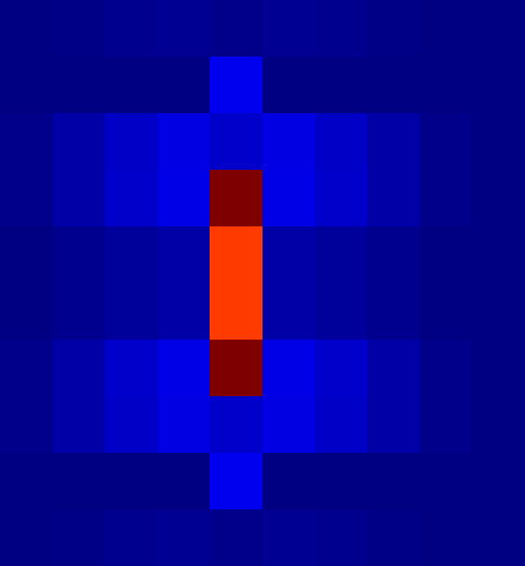
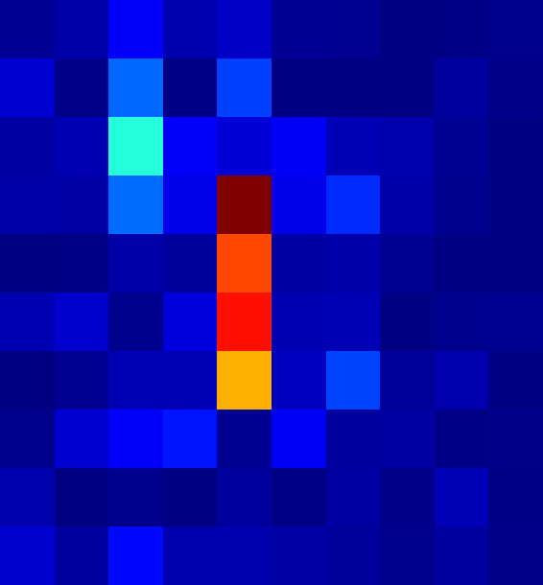
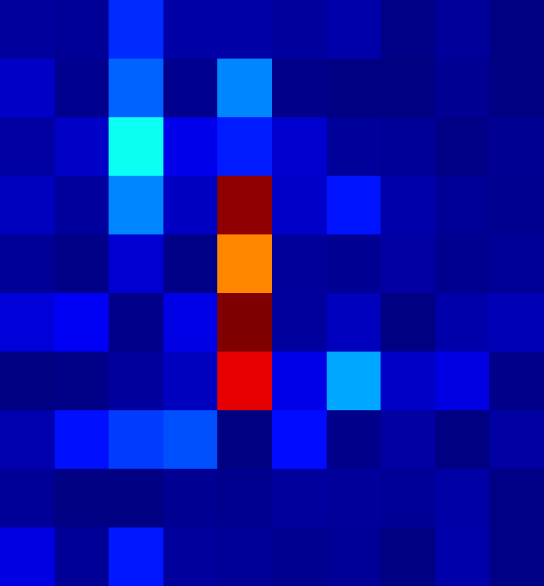
Full Flow of the Inverse Design
15
Intensity Distribution
Phase Distribution
Quantized Phase Distribution
1
3
3
2
2
2
2
2
10
Phase Modulation Logics
0.8
1
1
4
4
4
0.6
0
0
6
6
6
5
0.4
-1
-1
8
0.2
8
-2
8
-2
10
0
10
-3
10
-3
0
2
4
6
8
10
2
4
6
8
10
2
4
6
8
10
0
5
10
15
Laser Array Near Field
Imaginary gauge field
FFT
FFT
FFT
Desired Far Field
Recovered Far Field
Recovered Far Field
Recovered Far Field
1
2
2
500
2
400
2
350
0.8
350
300
4
4
400
4
300
4
0.6
250
250
6
6
300
6
200
6
200
0.4
200
150
8
150
8
0.2
8
100
8
100
100
10
10
10
50
10
50
2
4
6
8
10
0
2
4
6
8
10
2
4
6
8
10
2
4
6
8
10
III. Phase Modulated by Imaginary Gauge Field
I. Gerchberg-Saxton Phase Retrival
II. Nearfield Phase Quantization

Slide 3
Horizontal bar in the far field
Imaginary gauge field

Slide 4
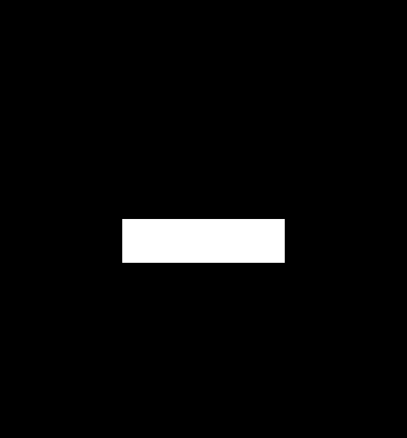
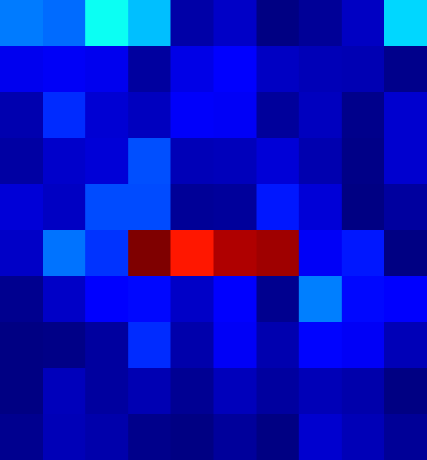
Horizontal bar in the far field
Desired Far Field Image
Recovered Far Field Image
1
15
300
2
2
250
0.8
Inverse engineering
FFT
4
10
Phase Modulation Logics
4
200
0.6
6
6
150
0.4
5
100
8
8
0.2
50
10
10
2
4
6
8
10
0
0
0
5
10
15
2
4
6
8
10

